Slide 1
Hungry slimes
Leo Marquette
Terence King
Alexander Brewer

Slide 2
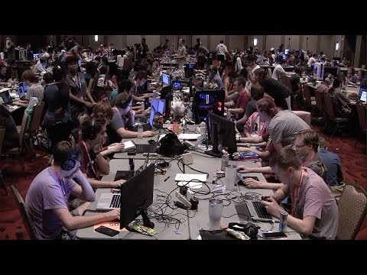
Chillenium 2018 Video

Slide 3
What was the chill
A 48 hour competition where teams from schools around the United States gather to compete and to create a functional game.
Over 370 students participated at Texas A&M 2018 Chillenium.
A game theme is provided at the start of the competition, the theme this year was transformations.
With the provided information, teams must devise a game utilizing this theme.

Slide 4
Our journey
Coming up with a game centering around the theme provided to us.
Brainstorming unique mechanics that will allow us to stand out against the competition.
Reaffirming our ideals about the game and the theme within it.
Creating a prototype.
Debugging prototype.
Creating another prototype.
Debugging.
Art Assets
Audio
More Debugging
Guess what was next? More Debugging
Final run through of the game.
Submission to judges.

Slide 5
Our trials
Determining how to create distinctive mechanics for our game.
First attempt at tying 3 programmers’ work into one project, was a challenge.
Building a fully physics based 2D game required an excessive amount of research and time investment.
Pacing ourselves within the 48 hour period and creating/meeting milestones was a unique challenge.
Overcoming our handicap of being new to the Unreal Engine, demanded… (finish later)

Slide 6
The end result
As programmers, we now have a better understanding of the Unreal Engine, and how it functions behind the scenes.
Our team has the ability to research data, and create a product under a time sensitive, high pressure situation, while sleep deprived.
A better comprehension of the trials and ordeals that come with making a game in a professional setting.
Overall the experience was invaluable, not only to our growth as programmers, but to our understanding of the industry.

Slide 7
In closing
A special shout out to our teachers Levent and Mari for attending the event with us, and their dedicated assistance through our troubles and overall experience.
Thank you HCC for allowing us to borrow your equipment, and giving us the opportunity to be on the same playing level as the other teams.

